Slide 1
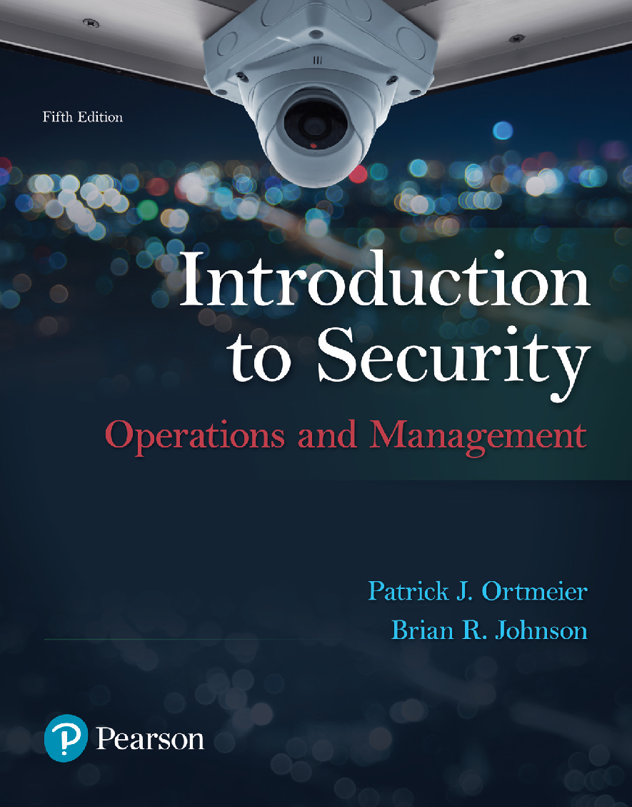
Introduction to Security: Operations & Management
5th Edition
Chapter 11
Managing People & Organizations

Slide 2
Learning Objectives (1 of 2)
After completing this chapter, the reader should be able to:
1. Explain the purpose of recruitment and selection
2. Describe some of techniques used in the recruitment and selection process
3. Define and explain negligent hiring & retention
4. Understand the purpose and methods used in employee development and training programs
5. Explain the purpose of employee performance appraisals
Notes:
Slide 2 is list of textbook LO numbers and statements

Slide 3
Learning Objectives (2 of 2)
6. Explain the difference between a policy and procedure
7. Identify some of the key elements and issues related to scheduling
8. Explain and describe plans, goals and objectives
9. Distinguish between and explain the different types of plans used in organizations
10. Discuss and explain budgeting and different types of budgets
Notes:
Slide 2 is list of textbook LO numbers and statements

Slide 4
Introduction
It is important to understand what managers do…
The core responsibilities of managers are reviewed in this chapter:

Slide 5
Personnel Recruitment & Selection (1 of 4)
Introduction:
Turnover:
Churn:

Slide 6
Personnel Recruitment & Selection (2 of 4)
Recruitment:
Personnel selection:
Recruitment techniques:

Slide 7
Personnel Recruitment & Selection (3 of 4)
The selection process:
Hiring off-duty police officers:

Slide 8
Personnel Recruitment & Selection (4 of 4)
Negligent hiring & retention:
  Negligent hiring:
  Negligent retention:

Slide 9
Employee Development & Training
Introduction/Definitions:
Two ways to improve employee performance:

Slide 10
Performance Appraisal
Introduction/Definitions:
Key points:
Promotions & discipline:

Slide 11
Policies & Procedures
Introduction/Definitions:
  Policy
  Procedures
  Functions

Slide 12
Scheduling
Introductions/Definitions:
Scheduling terms:
Other points:

Slide 13
Planning (1 of 3)
Introduction/Definitions:

Slide 14
Planning (2 of 3)
Types of Plans:
  Strategic
  Tactical
  Operational
  Repeat Use

Slide 15
Planning (2 of 3)
Performance Measures:
  What are performance measures?
  Types of standards:
  Methods for measuring performance:
  Quality assurance:

Slide 16
Budgeting
Introduction/Definitions:
Types of budgets:
  Line
  Performance-based
  Zero-based
Cost/benefit analysis:

Slide 17
Career Opportunities
Industrial Security Managers:
Chief Security Officers:

